Slide 2
Presentation Style Guide
Format: Use this template for all ECCO Presentations
Font: Verdana
Colours: Use colours pre-set in this template

Slide 3
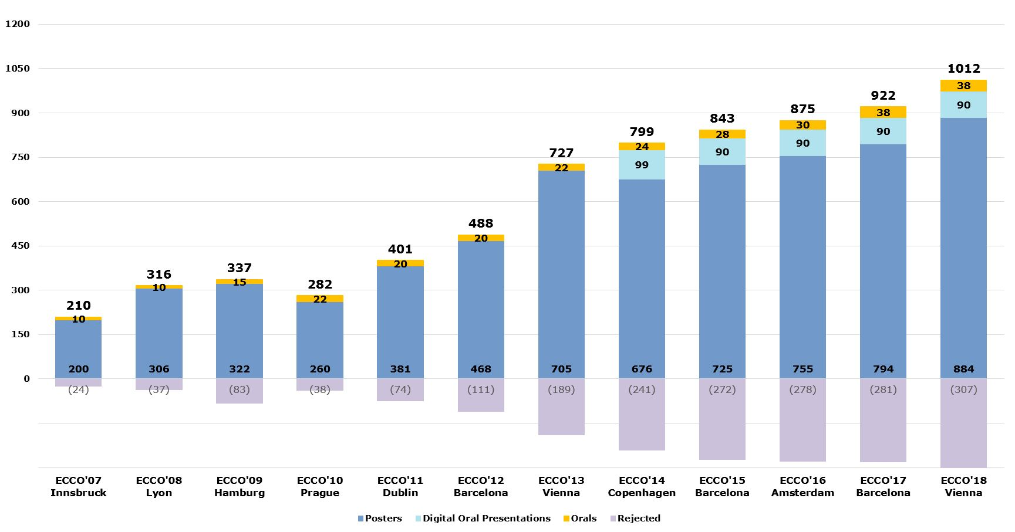
Sample statistic

